Slide 1
UNIT I INTRODUCTION TO ALGORITM DESIGN
Session - 2

Slide 2
Why to design an algorithm?
General approaches to the construction of efficient solutions to problems
They provide templates suited for solving a broad range of diverse problems.
They can be translated into common control and data structures provided by most high-level languages.
The temporal and spatial requirements of the algorithms which result can be precisely analyzed.

Slide 3
Algorithm Design Approaches
Based on the architecture
Top Down Approach
Bottom up Approach

Slide 4
Algorithm Design Techniques
1. Brute Force
To solve a problem based on the problem’s statement and definitions of the concepts involved.
Easiest approach to apply
Useful for solving small – size instances of a problem.
Some examples of brute force algorithms are:
Computing a^{n} (a > 0, n a nonnegative integer) by multiplying a*a*…*a
Computing n!
Selection sort, Bubble sort
Sequential search

Slide 5
2. Divide-and-Conquer & Decrease-and-Conquer
Step 1
Split the given instance of the problem into several smaller sub-instances
Step 2
Independently solve each of the sub-instances
Step 3
Combine the sub-instance solutions.
With the divide-and-conquer method the size of the problem instance is reduced by a factor (e.g. half the input size),
With the decrease-and-conquer method the size is reduced by a constant.

Slide 6
Examples of divide-and-conquer algorithms:
Computing a^{n} (a > 0, n a nonnegative integer) by recursion
Binary search in a sorted array (recursion)
Mergesort algorithm, Quicksort algorithm recursion)
The algorithm for solving the fake coin problem (recursion)

Slide 7
3. Greedy Algorithms "take what you can get now" strategy
At each step the choice must be locally optimal
Works well on optimization problems
Characteristics
1. Greedy-choice property: A global optimum can be arrived at by selecting a local optimum.
2. Optimal substructure: An optimal solution to the problem contains an optimal solution to sub problems.
Examples:
Minimal spanning tree
Shortest distance in graphs
Greedy algorithm for the Knapsack problem
The coin exchange problem
Huffman trees for optimal encoding

Slide 8
4.Dynamic Programming
Finds solutions to subproblems and stores them in memory for later use.
Characteristics
1. Optimal substructure:
Optimal solution to problem consists of optimal solutions to subproblems
2. Overlapping subproblems:
Few subproblems in total, many recurring instances of each
3. Bottom up approach:
Solve bottom-up, building a table of solved subproblems that are used to solve larger ones.
Examples:
Fibonacci numbers computed by iteration.
Warshall’s algorithm implemented by iterations

Slide 9
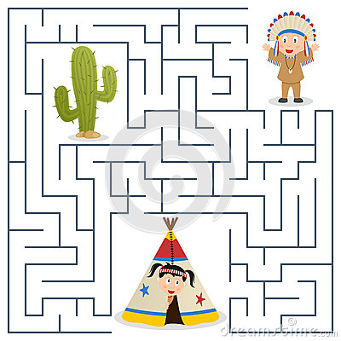
5. Backtracking methods
The method is used for state-space search problems.
What is State-space search problems
- State-space search problems are problems, where the problem representation consists of:
initial state
goal state(s)
a set of intermediate states
a set of operators that transform one state into another.
a cost function – evaluates the cost of the operations (optional)
a utility function – evaluates how close is a given state to the goal state (optional)
The solving process solution is based on the construction of a state-space tree
The solution is obtained by searching the tree until a goal state is found.
Examples:
DFS problem
Maze problems

Slide 10
6. Branch-and-bound
Branch and bound is used when we can evaluate each node using the cost and utility functions.
At each step we choose the best node to proceed further.
Branch-and bound algorithms are implemented using a priority queue.
The state-space tree is built in a breadth-first manner.
Example:
8-puzzle problem.
N queens problem

Slide 11
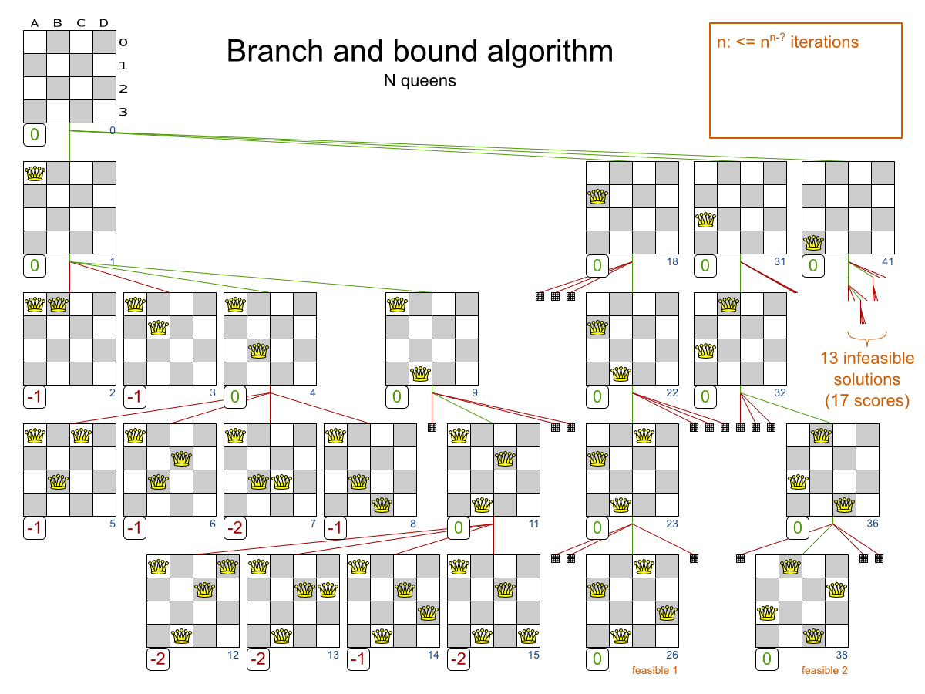

Slide 12
Recollect
Different design Approaches/ Design Paradigms
Brute force
Divide and Conquer
Greedy Algorithms
Dynamic Programming
Backtracking
Branch and Bound
Unit 2
}Unit 3
Unit 4
Unit 5

